Slide 1

CUSTOMER LEAD ANALYSIS
Jeya Raman Sekar

Slide 2



01
MISSION
Need to do Depth Analysis
Explore Data
Data Preparation
Let’s begin

Slide 3


02
VISION
As a Analyst, need to give suggestions & recommendations
Presentations are tools that can be used as lectures, speeches, reports, and more.

Slide 4
03
Hi There....
WELCOME
Agenda – Introduction – Problem Statement – Data Understanding – Data Cleaning – Data Analysis – Data Visualization – Recommendations - Conclusion

Slide 5

04
Introduction
An Edu-Tech company receives leads from various sources. To improve lead conversion strategies, they have decided to use data-driven analysis to make informed decisions. This approach will help the company optimize resource allocation, prioritize high-potential leads, and enhance conversion rates, ultimately driving better business outcomes.

Slide 6
05
PROBLEM STATEMENT
An online Edu-Tech platform generates leads from various sources. The marketing and sales teams aim to optimize lead conversion rates and enhance the efficiency of their lead management process.
Optimize Lead Conversion: The primary goal is to improve the lead conversion rate by identifying which leads are most likely to convert into paying customers.
Prioritize High-Potential Leads: Help the marketing and sales teams prioritize leads with the highest conversion potential to focus resources effectively.
02
01
Tailor Marketing Strategies: Customize marketing and sales strategies based on lead behavior and characteristics for better engagement and conversion.
Data-Driven Decisions: Use the available dataset to make informed decisions that improve lead management and resource allocation.
03
04

Slide 7




06
Data Analysis
Before getting into data analysis, got the understanding of data in detail, business requirements, EDA analysis, and recommendations

Slide 8
Data Analysis
07
A comprehensive analysis was conducted to clean, explore, and visualize the data for actionable insights into lead conversion strategies.
Understanding Data & Business Requirements: Analyzed the dataset to align with business objectives, focusing on lead conversion factors.
Data Cleaning: Addressed duplicates, missing values, and standardization to ensure data quality.
A
B
Exploratory Data Analysis (EDA): Performed statistical analysis to uncover key conversion influencers like lead source and engagement.
In-depth Analysis & Visualizations: Developed visual insights to identify trends, aiding targeted marketing and resource allocation.
C
D

Slide 9



08
EDA
A thorough analysis was conducted to uncover key insights influencing lead conversion.
Summary Statistics: Examined data distributions, including averages, medians, and outliers, to understand the overall patterns in lead behavior.
Exploratory Data Analysis
AI-powered Key Influencer Analysis: Leveraged advanced AI techniques to pinpoint the most critical factors driving lead conversions, helping in data-driven decision-making.

Slide 10
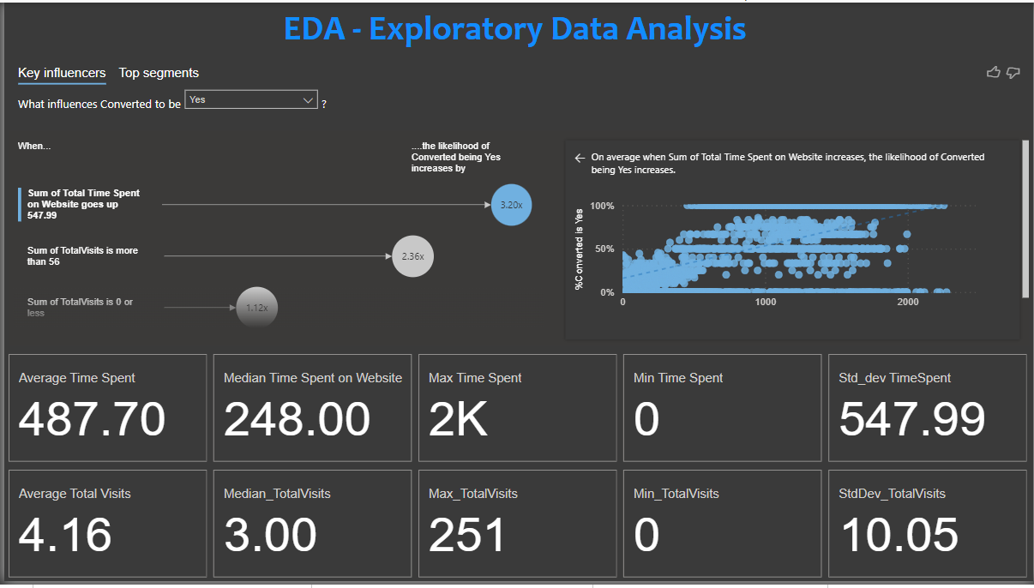
09
EDA
Visualize Key Influencers: Display the graph showing how the likelihood of conversion increases with time spent and visits.
Segment Analysis: Present leads segmented by their engagement levels (time spent and visits) to show how resource allocation can be improved.

Slide 11
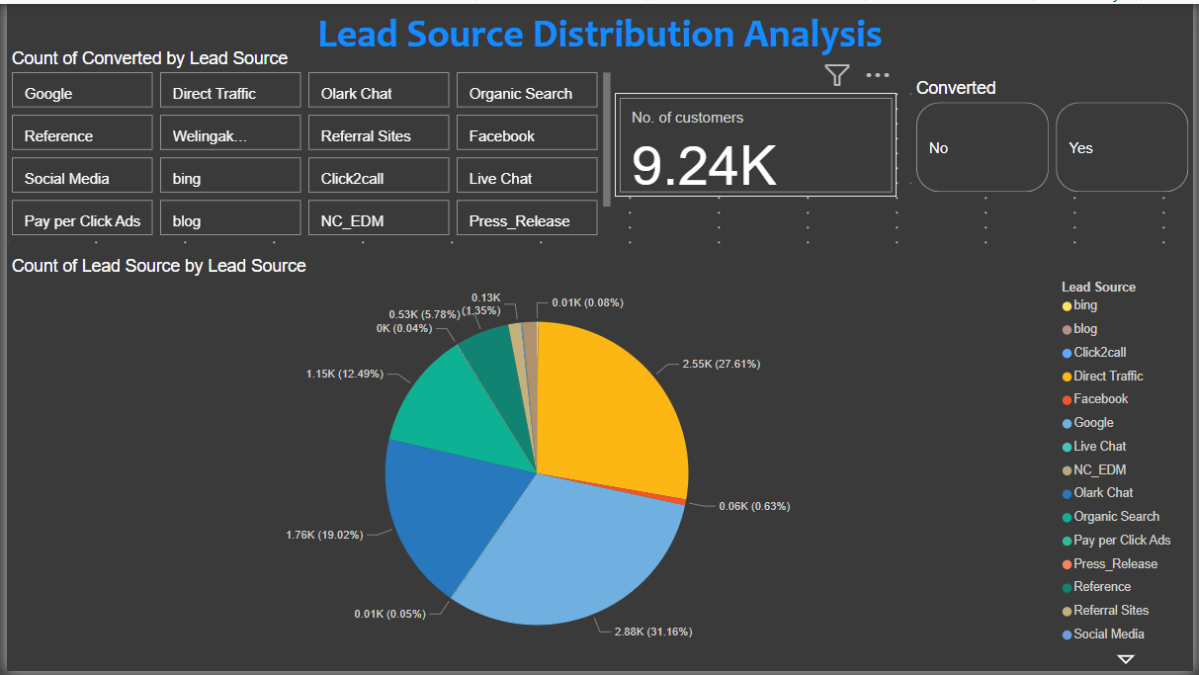

10
LEAD SOURCE DISTRIBUTION
Analyzed the distribution of leads across different sources to identify high-performing channels.
Lead Source Breakdown: Visualized the share of leads from various sources, including organic, paid, referrals, and social media.
Conversion Potential: Highlighted which sources generate the highest and lowest conversion rates, helping to identify effective channels.
Channel Optimization: Insights enable better allocation of marketing resources toward sources with higher lead conversion potential.
Strategic Focus: Used data to tailor marketing strategies and boost lead acquisition from high-performing channels.

Slide 12

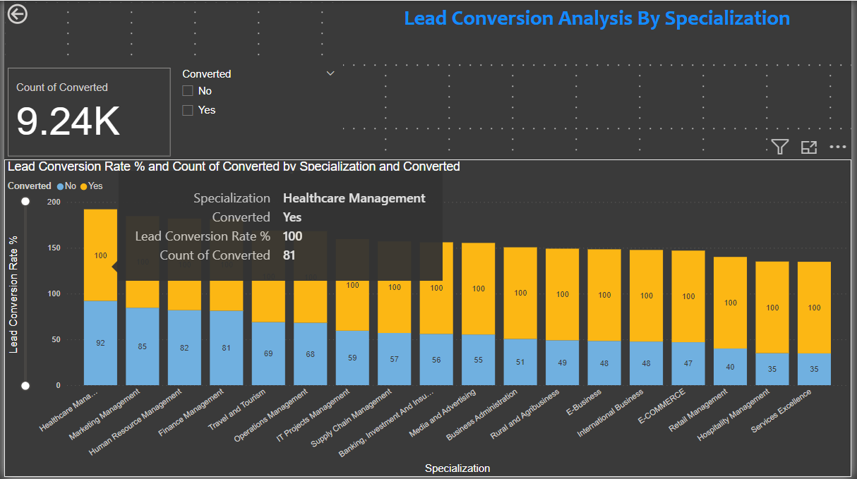
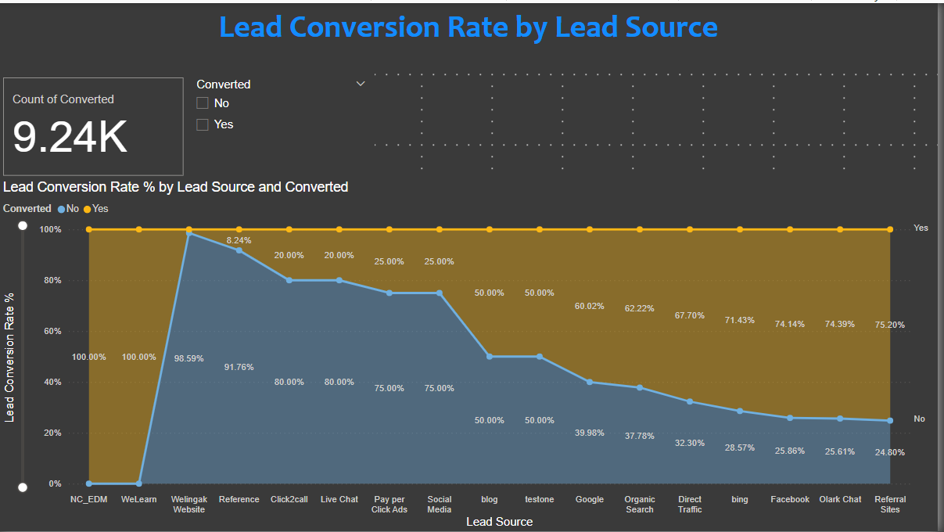
LEAD CONVERSION RATE
11
This analysis explores conversion rates by lead source and specialization, providing insights into which channels and focus areas perform best.

Slide 13


12
ANALYTICS AREA
Conversion by Lead Source: Visualized conversion rates for each lead source (e.g., organic, paid, referrals) to identify high-converting channels.
Specialization Focus: Analyzed conversion rates across different specializations (e.g., IT, marketing, finance) to understand which areas attract leads that are more likely to convert.
High-Performing Combinations: Identified the best-performing combinations of lead source and specialization, highlighting which channels are most effective for specific focus areas.

Slide 14

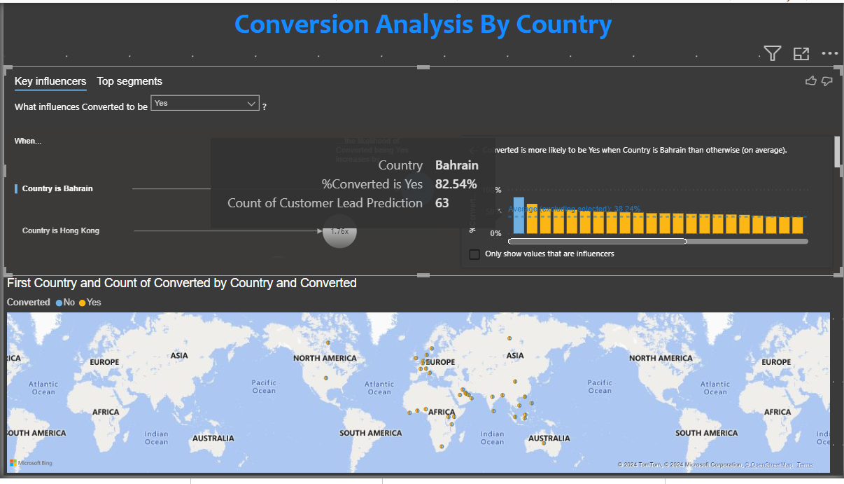
13
Lead Conversion By Country
Key influencers and segment analysis explanation

Slide 15
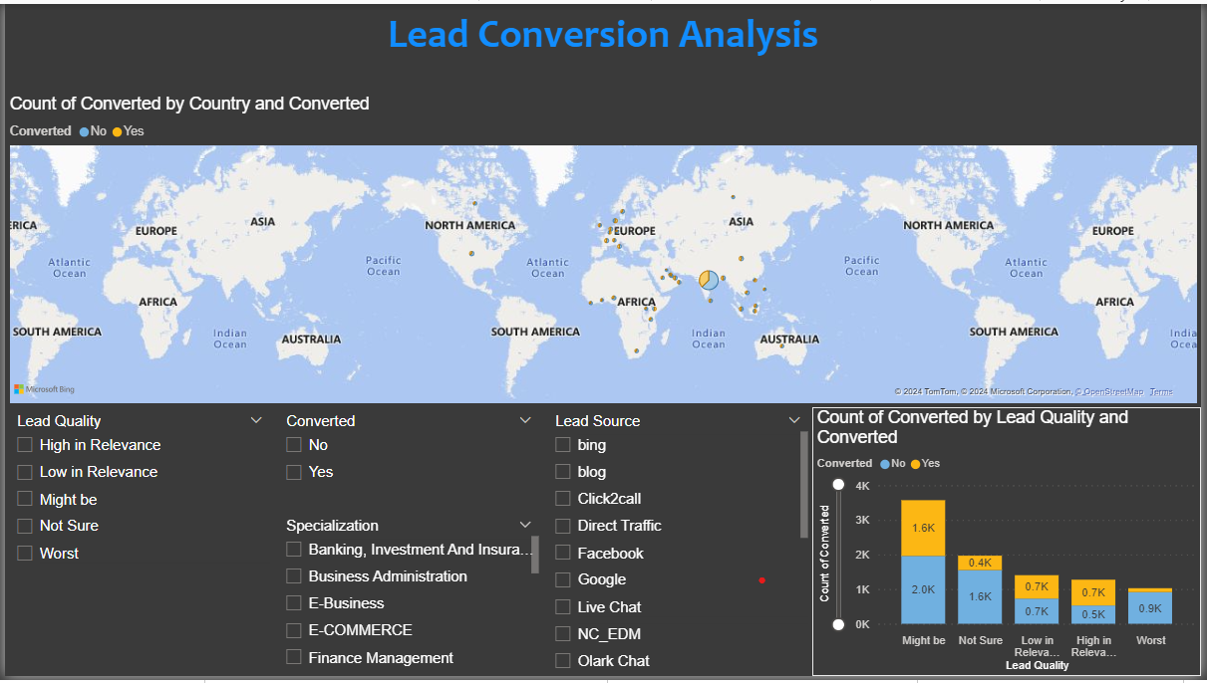
14
Lead Conversion Analysis
Let’s give detailed explanation of lead conversion analysis

Slide 16
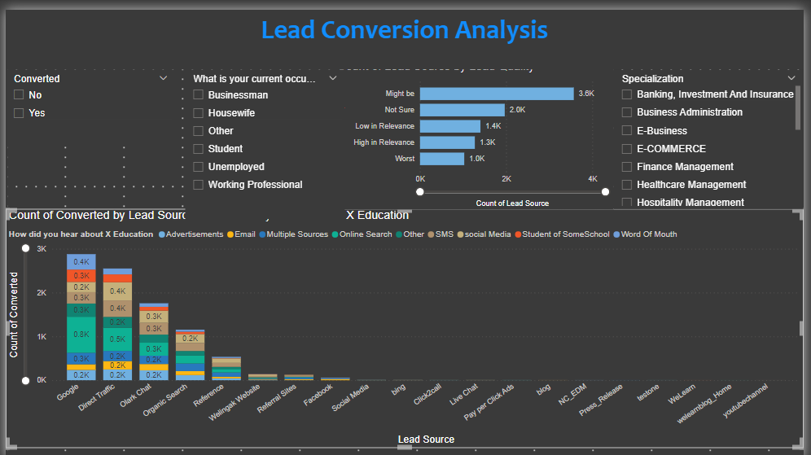



15
Need to focus lead source and Lead Quality
COMPETITIVE ANALYTICS
Specialization and occupation alerts more important
Presentations are tools that can be used as lectures, speeches, reports, and more. It is mostly presented before an audience.
Key insights and suggestions

Slide 17
16
KEY INSIGHTS
Conversion Rate:
38.5% of the leads in the dataset converted into paying customers, while 61.5% did not.
2. Engagement Metrics:
Leads who converted spent more time on the website (average 738.5 seconds) compared to non-converted leads (average of 330.4 seconds).
Converted leads had more total visits (average 5.3 visits) compared to non-converted leads (average 3.4 visits).
Page views per visit were slightly higher for converted leads (2.55 vs. 2.39).
3. Lead Quality:
Converted leads had slightly higher Asymmetrique Profile and Activity Scores (indicating a higher likelihood of engagement and relevance to the platform).

Slide 18

17
RECOMMENDATIONS

Slide 19
Q1: Which leads are most likely to convert into paying customers?
18
High engagement leads: Leads with more visits, longer time spent on the website, and higher page views per visit are more likely to convert. Focus on leads that visit the website multiple times and stay longer.
Leads with higher Asymmetric Profile and Activity Scores should be prioritized as they reflect better alignment with the platform's target audience.
Key Factors Influencing Conversion:
Time Spent on Website: The likelihood of conversion significantly increases (by 3.20x) when the total time spent on the website exceeds 547.99 seconds.
Total Visits: If the lead has more than 56 visits, the likelihood of conversion increases by 2.36x.
Leads with zero visits or very low engagement have a significantly lower likelihood of conversion.

Slide 20

19
LEAD CONVERSION
38.5%
38.5% of the leads in the dataset converted into paying customers, while 61.5% did not.

Slide 21
20
Q2: How can the platform prioritize and allocate resources to leads with the highest conversion likelihood?
Lead Scoring System: Implement a lead scoring model based on engagement metrics such as the total number of visits, time spent on the website, and profile scores. Leads with higher scores can be prioritized for follow-up.
Behavioral Segmentation: Segment leads based on their interaction patterns. For example, those spending more time on the site and engaging more frequently could receive immediate attention from sales teams.

Slide 22
21
Q2: How can the platform prioritize and allocate resources to leads with the highest conversion likelihood?
Refine Lead Scoring System:
Build a lead scoring model that assigns higher scores to leads with more than 500 seconds spent on the site and multiple visits (e.g., 5 or more).
Leads with no or minimal engagement should be deprioritized for sales follow-up but can be targeted with retargeting ads or drip email campaigns to re-engage them.
2. Segment and Target Based on Behavior:
Segment leads into buckets based on their time spent and visits. For example:
Highly Engaged: More than 500 seconds, 5+ visits.
Moderately Engaged: 250-500 seconds, 2-5 visits.
Low Engagement: Less than 250 seconds, 1-2 visits.

Slide 23
22
Q3: Marketing and Sales Strategies:
Targeted Content Marketing: Customize content for highly engaged leads. For example, personalized email campaigns or retargeting ads based on pages visited can increase the chances of conversion.
Tailored Offers for High Engagement: Offer discounts, personalized learning paths, or exclusive webinars to leads who spend more time on the website or have higher engagement scores.
Optimize Marketing for Conversions:
Focus on retargeting campaigns for leads that spend significant time on your site but haven’t yet converted.
Implement A/B testing on landing pages or content that high-engagement users interact with to further optimize for conversion.

Slide 24
23
Q4: How can the lead management process be streamlined and made more effective?
Automated Lead Nurturing: Use automated workflows to nurture high-potential leads by sending timely follow-up emails or notifications when leads hit certain engagement thresholds.
Predictive Analytics: Incorporate machine learning models to predict lead conversion likelihood based on the interaction data, which can help in better resource allocation and prioritization of high-potential leads.

Slide 25
24
Q4: How can the lead management process be streamlined and made more effective?
Automation in Lead Management:
Set up automated triggers for sales teams when a lead surpasses certain engagement thresholds, such as more than 500 seconds or 3 visits.
Automate follow-up emails for leads who have visited more than 5 times but haven't converted yet.

Slide 26

25
Q & A

Slide 27

THANK YOU!

